Slide 1


Hii,
Iam Siddhika
Welcome to Power BI Series
Part -73

Slide 2



I’m very excited to dive into this with you all!
Are you ready to enhance your data visualization skills?
We focus only on the most used and important Visuals
Today Content
VISUALIZING DATA
DRILL DOWN FEATURE
ABOUT DRILL ICONS

Slide 3


DRILL DOWN
check next slide ..
Drill down allows users to navigate through different levels of data hierarchy within a visual, providing a more detailed view of the data.
It's an interactive feature that helps users explore data from a high-level summary to more granular details.
When to Use:
To analyze data across different hierarchical levels, such as Year > Quarter > Month > Day.
To gain insights by examining detailed data within a broader category.
To allow users to explore data trends and patterns at various levels of aggregation.

Slide 4

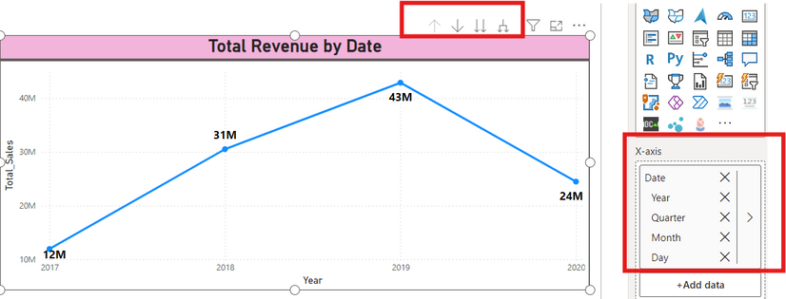
Example
let's consider a scenario where we have a visual displaying total Revenue by year. By enabling drill down, users can click on a particular year to see sales broken down by quarter, and then click further to see sales by month within that quarter etc.
check next slide
to get more info
Purpose:
To enable a detailed examination of data, starting from a high-level overview and drilling down into more specific information.
To make reports interactive and provide users with the flexibility to explore data on their own.

Slide 5






ABOUT DRILL ICONS
There are four key drill functionalities, each represented by a distinct icon
Drill Up: Click to go back to a higher-level summary of your data.
Drill Mode: Turn it on to enable interactive drilling into specific data points by clicking on them.
Expand All Down One Level: Click to see all detailed data for the next level of hierarchy for all categories simultaneously.
Expand One Level at a Time: Expand the selected data point down one level in the hierarchy while maintaining the current level context for other data points.
got it

Slide 6


Thank you for joining me today to learn about Part -73 of Power BI!
Remember, Effective data visualization is crucial for turning data into meaningful insights and compelling narratives with Power BI.
Stay tuned for more insights and tips on Power BI in our next Series.
Follow

